Slide 1
Eco Devo 101:
A Discussion Guide for Kansas Food Councils

Slide 2
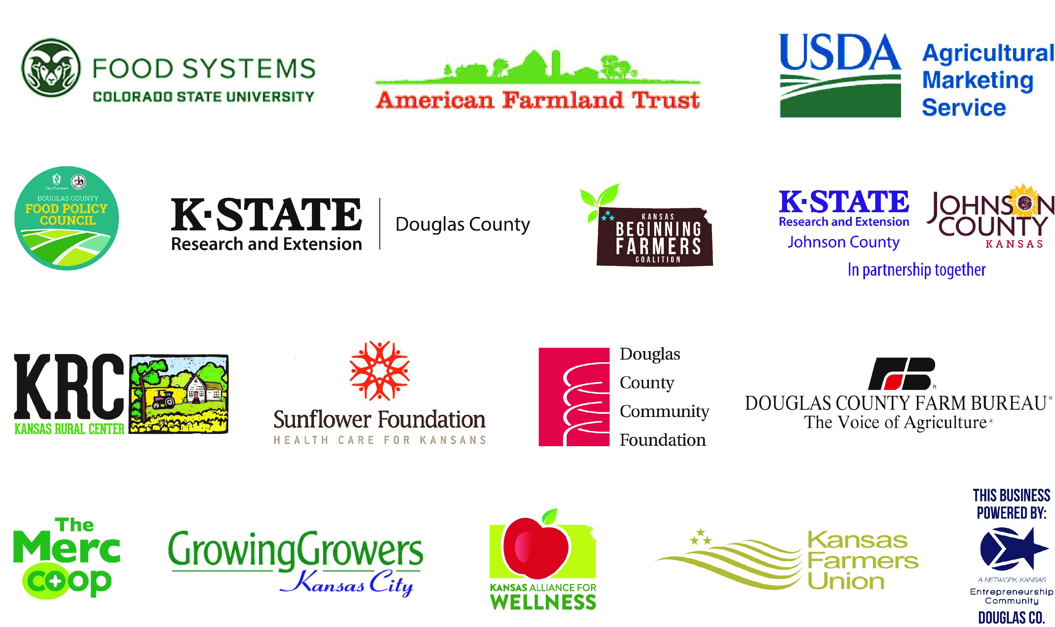
Where did this guide come from?
In May 2018, these partner organizations hosted the Harvesting Opportunity Symposium to discuss:
How can we build true community wealth in Kansas through food and farming?
One of the key takeaways was that the food and farm councils in Kansas want to connect to their economic development partners to discuss these ideas.
The slides that follow are a guide to help you do just that!

Slide 3
What is economic development (eco devo)?
Investments, strategies, and policies that aim to improve prosperity.
Typically, this means:
creating and/or retaining jobs,
supporting higher incomes,
or growing the tax base.

Slide 4
Economic Development Tools
Business improvement districts, or similar public-private partnerships
Community Development Block Grants
Affordable housing bonds
Tax credits
Tax abatement
Tax increment financing (TIF)
Tourism initiatives
Bond issuance
Small business assistance programs
Industrial site development
Enterprise Zones
Revolving loan funds

Slide 5
What are examples of economic development tools used in our community?

Slide 6
How does economic development relate to our work on our community’s food system?
In community food systems, the food is produced, processed and distributed near its point of consumption.
The shorter supply chain can ensure that more dollars flow directly to producers and provide economic benefits to the local community.

Slide 7
Economic benefits of community food systems:
Profitable agricultural businesses
Successful entrepreneurs and small businesses
Good jobs and career opportunities

Slide 8
What are some examples of local food businesses in our community? How do they create community economic benefits?

Slide 9
What new vocabulary might we need?
In economic development, there are some key terms to know when making the argument for the benefits of investing in community food systems:
Buy Local
Local Multiplier
Import Substitution

Slide 10
Buy local: Local purchasing is a preference to buy locally produced goods and services over those produced farther away.
Reasons to buy local:
Builds community
Strengthens the local economy
Creates local jobs

Slide 11
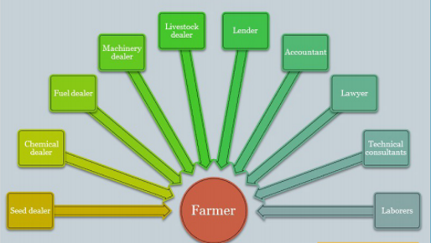
Local multiplier
The multiplier effect is the amount of local economic activity that is triggered by the purchase of any one item.
The more a dollar circulates in a defined region, the more income, wealth and jobs it creates.

Slide 12
Import substitution
Import substitution is a strategy that has the potential to both retain dollars within a region, and create a multiplier effect from new production.
In classical economics, all import purchases result in a reduction in regional incomes. When local goods are substituted for imported goods, regional incomes grow.

Slide 13
So how do Food Councils across the state work on eco devo?
They engage with their economic development professionals so they can educate and learn with the Council.
They propose policies, programs, and investments to help support local food businesses and farms in their communities.
So, some questions to ask ourselves…

Slide 14
1. How can we engage with economic development partners?
Have we worked with the economic development groups in our community?
Do they have a seat on the council?
Have we invited them to come speak to us?
Have we gone to meet with their boards and staff members?

Slide 15
2. How do we determine what policy or investment solutions might work in our community?
What resources exist in our community to help new farmers or food entrepreneurs get started?
Do new food businesses in our community know where to go to access information about permits, funding, etc?
Who in the community helps food entrepreneurs navigate these processes?

Slide 16
3. How do we move those policy or investment ideas forward?
What should be our first step?
Who on our council wants to work on this?

Slide 17
How can we learn more?
In May 2018, stakeholders across the state convened for the Harvesting Opportunity Symposium, and shared their ideas for growing community food systems in Kansas.
The Federal Reserve and U.S. Department of Agriculture collaborated to study regional food systems as a means for enhancing economic opportunity. The resultant publication, Harvesting Opportunity: The Power of Regional Food System Investments to Transform Communities, highlights recent findings and opportunities in this sector.
The U.S. Department of Agriculture Agricultural Marketing Service convened a team of regional economists and food system specialists to develop a best practice toolkit for evaluating the economic impacts of local food system activities.

Slide 18
What are some resources we can tap into?
USDA offers more than 30 grant, loan and cost-share programs to support community food systems throughout the supply chain.
The Kansas Healthy Food Initiative (KHFI) is a public-private partnership that provides technical assistance for those seeking to strengthen access to healthy foods as well as financing through a mix of loans and grants to develop new or renovate fresh food retail in underserved communities throughout Kansas.
Network Kansas supports an entrepreneurial environment in Kansas by providing a central portal that connects entrepreneurs and small business owners with expertise, education, and resources to grow their businesses and communities.

